Slide 1
ELECTRONIC DEVICES
Course Instructor:
Umang Raj Pandey

Slide 2
Chapters
1.Semiconductor Diode
2.Non-linear Model
3.Bipolar Junction Transistor
4.BJT biasing and Thermal Stabilization
5.Small Signal Analysis of BJT Amplifier
6.JFET and its biasing techniques
7.Metal Oxide Semiconductor
8.Rectifiers,Clippers and Clampers

Slide 3
Chapter 1:Semiconductor Diode
Conductors: Elements which allow the flow of electric current through it by the application of voltage. Example:Metals,graphite,human body,etc.
Insulators: Elements which do not allow any flow of electric charge. Example:glass,air,plastic,rubber,wood,etc.
Semiconductors: Elements whose conductivity lies between the conductivity of conductor and insulator. Example:Silicon,Germanium,etc.

Slide 4
Effect of temperature
In Semiconductor: The resistivity of semiconductor decreases with increase in temperature.
In Conductor: The resisitivity of conductor increases with increase in temperature.
In Insulator: The resisitivity of insulator is constant at certain temperature.

Slide 5
Types of Semiconductors
1.Intrinsic Semiconductors
2.Extrinsic Semiconductors
a) N-type semiconductor
b) P-type semiconductor

Slide 6
Intrinsic semiconductor
Pure form of semiconductor.
Conductivity by breaking of covalent bond.
The breaking of covalent bond creates electrons and hole pair.
Holes are considered as positive charge whereas electrons are considered as negative charge.

Slide 7
Conductivity in intrinsic semiconductor
When electrons are released during breaking covalent bonds,they move randomly through crystal lattice.
When an external electric field is applied to pure intrinsic semiconductor, the free electrons in conduction band move towards the positive terminal while the holes move towards the negative terminal of the battery.
As a result, an electric current flows.

Slide 8
Extrinsic Semiconductor
To get the proper conduction in semiconductor other elements are added to them. The added elements are called impurities in semiconductor.
The process of adding impurities to the semiconductor is called dopping.
The elements used for dopping are either pentavalent (5 valence electrons) or trivalent(3 valence electrons).
The dopped semiconductor is called extrinsic semiconductor.
Types:
N-type semiconductor
P-type semiconductor

Slide 9
N-type semiconductor
When pentavalent atoms such as phosphorous are used as dopant in the dopping process,the N-type extrinsic semiconductor is formed.
Due to the presence of 5 electrons in outermost orbit the majority carriers of this material are electrons.

Slide 10
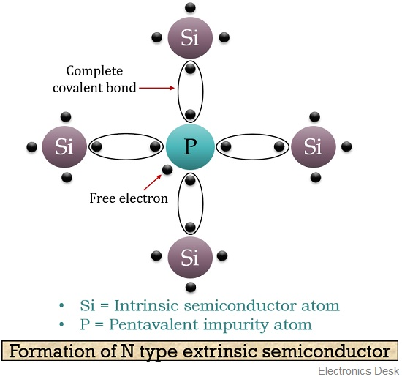

Slide 11
P-type semiconductor
When the trivalent atom such as aluminium are used as dopant in dopping process the p-type extrinsic semiconductor is formed.
Due to the presence of three electrons in the outermost shell the majority carrier is hole.

Slide 12
